Slide 1
Innovation, Engagement, & Personalized Learning in ASD-S
October 9, 2019

Slide 2
Meet the Team
Melissa Savoie- Skilled Trades & Innovation Subject Coordinator
Laura Taylor- Innovation & Student Engagement Coach
Jillian Jamieson- Innovation & Personalized Learning Coach

Slide 3
Highlights from 2018-2019
$50,000 in grants awarded last year
43 Grants were awarded
14/43 High School
12/43 Middle School
17/43 Elementary School
24 Saint John Ed Centre
11 Hampton Ed Centre
8 St. Stephen Centre

Slide 4
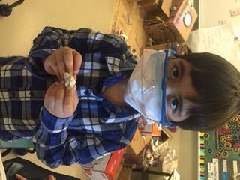
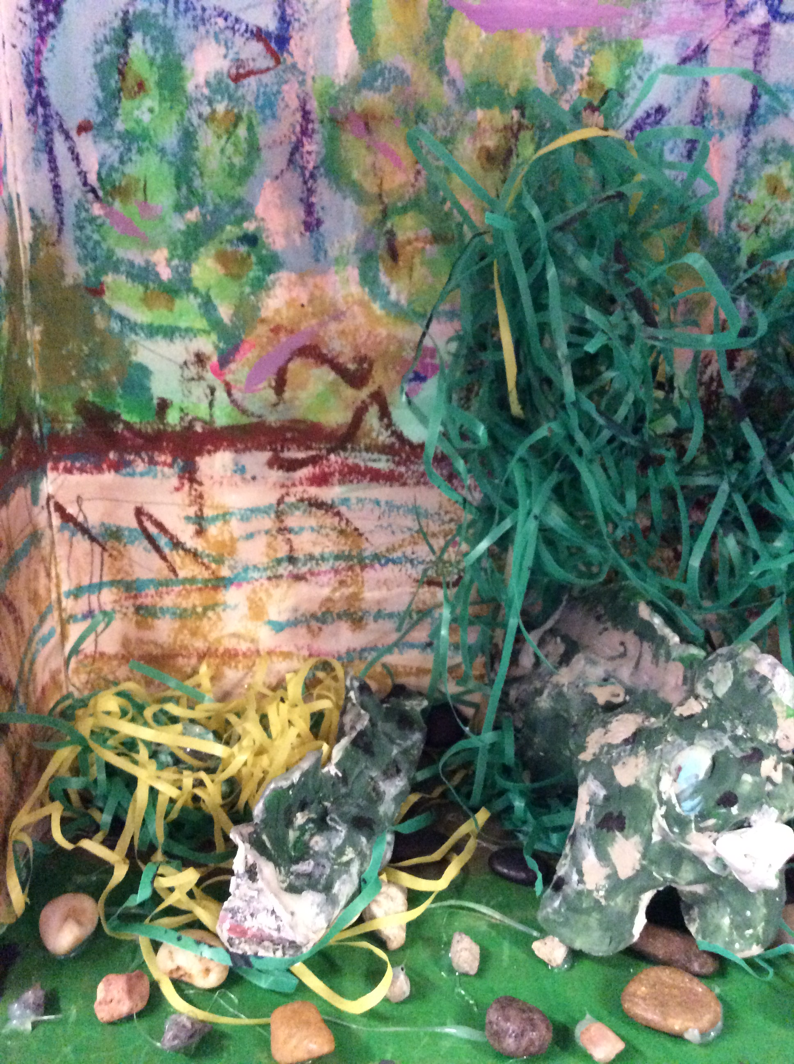
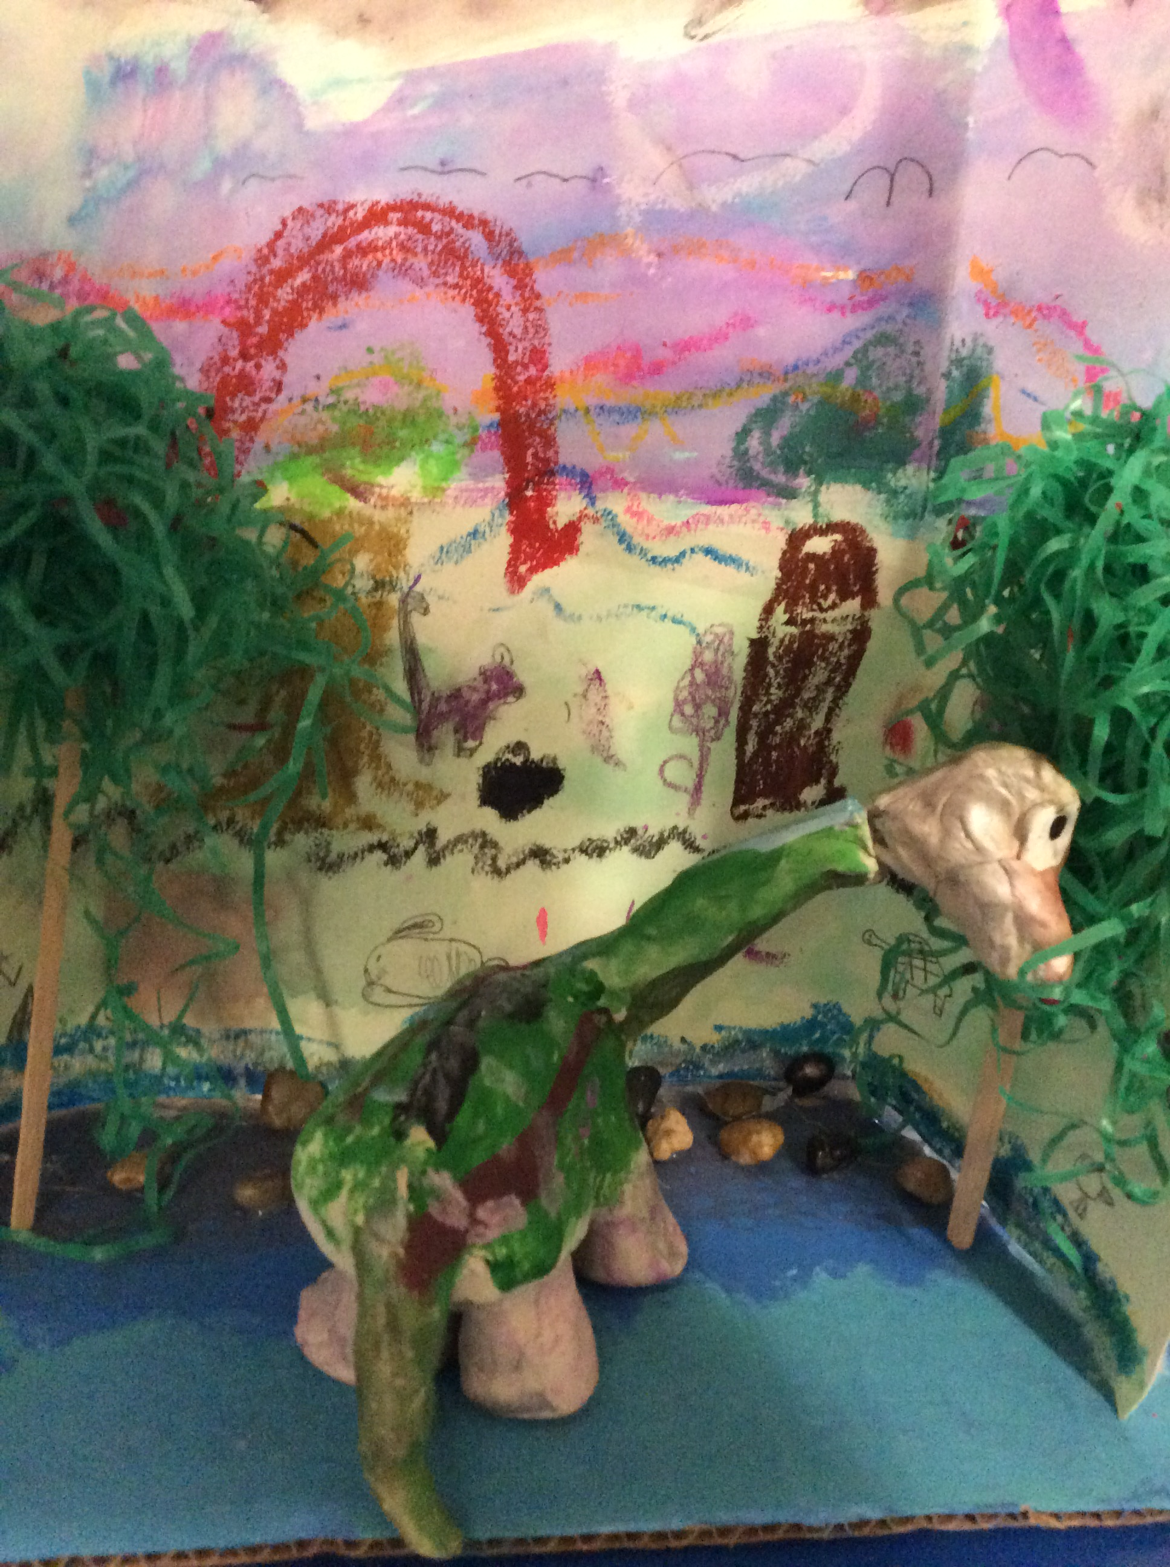
2018-2019 Stories of Success Deer Island Community School- Michelle Kelson's K-1 group

Slide 5
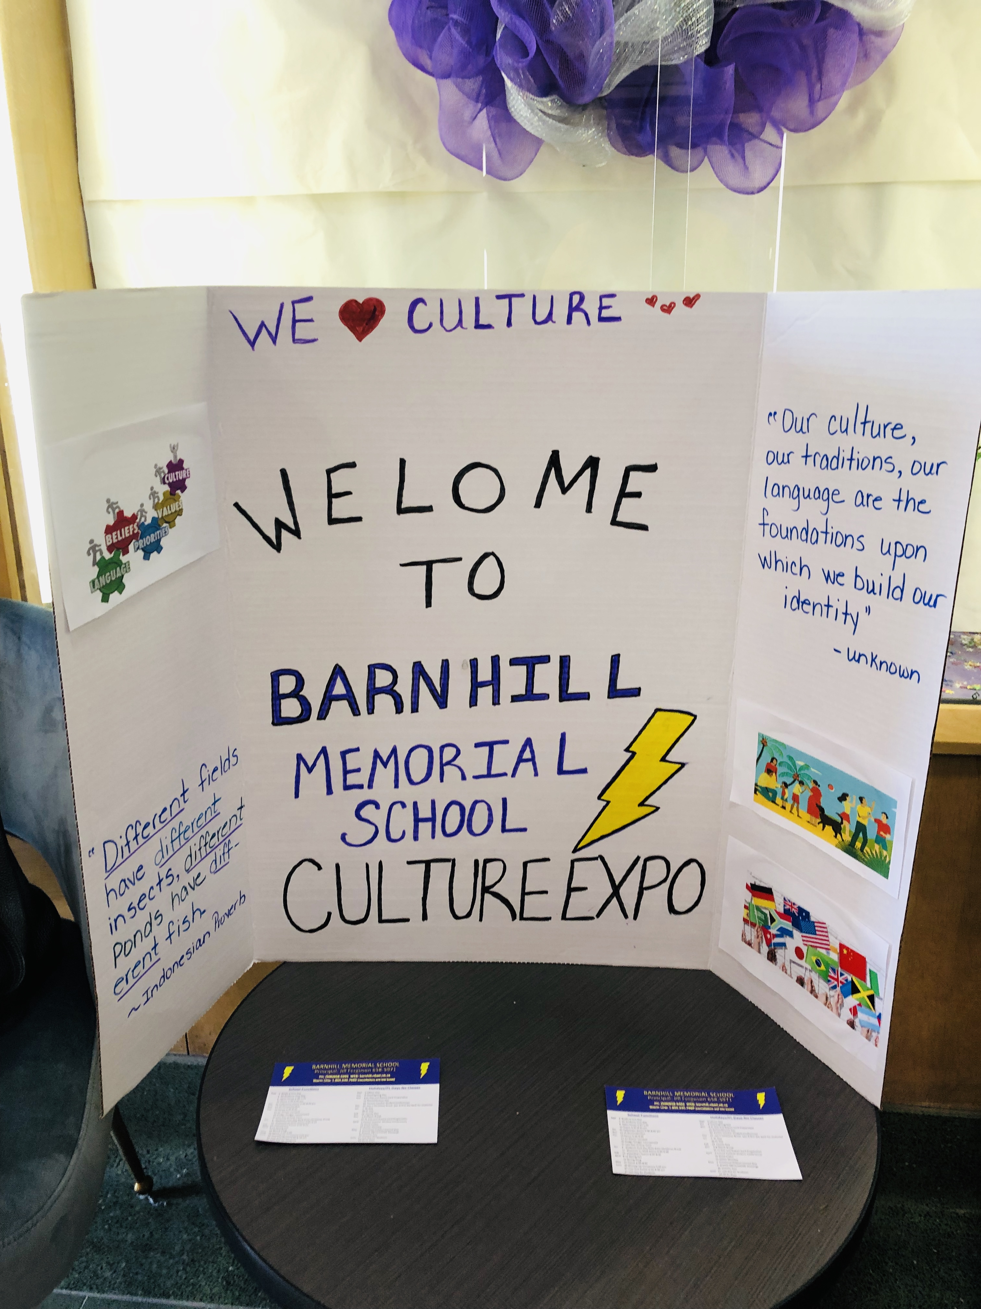
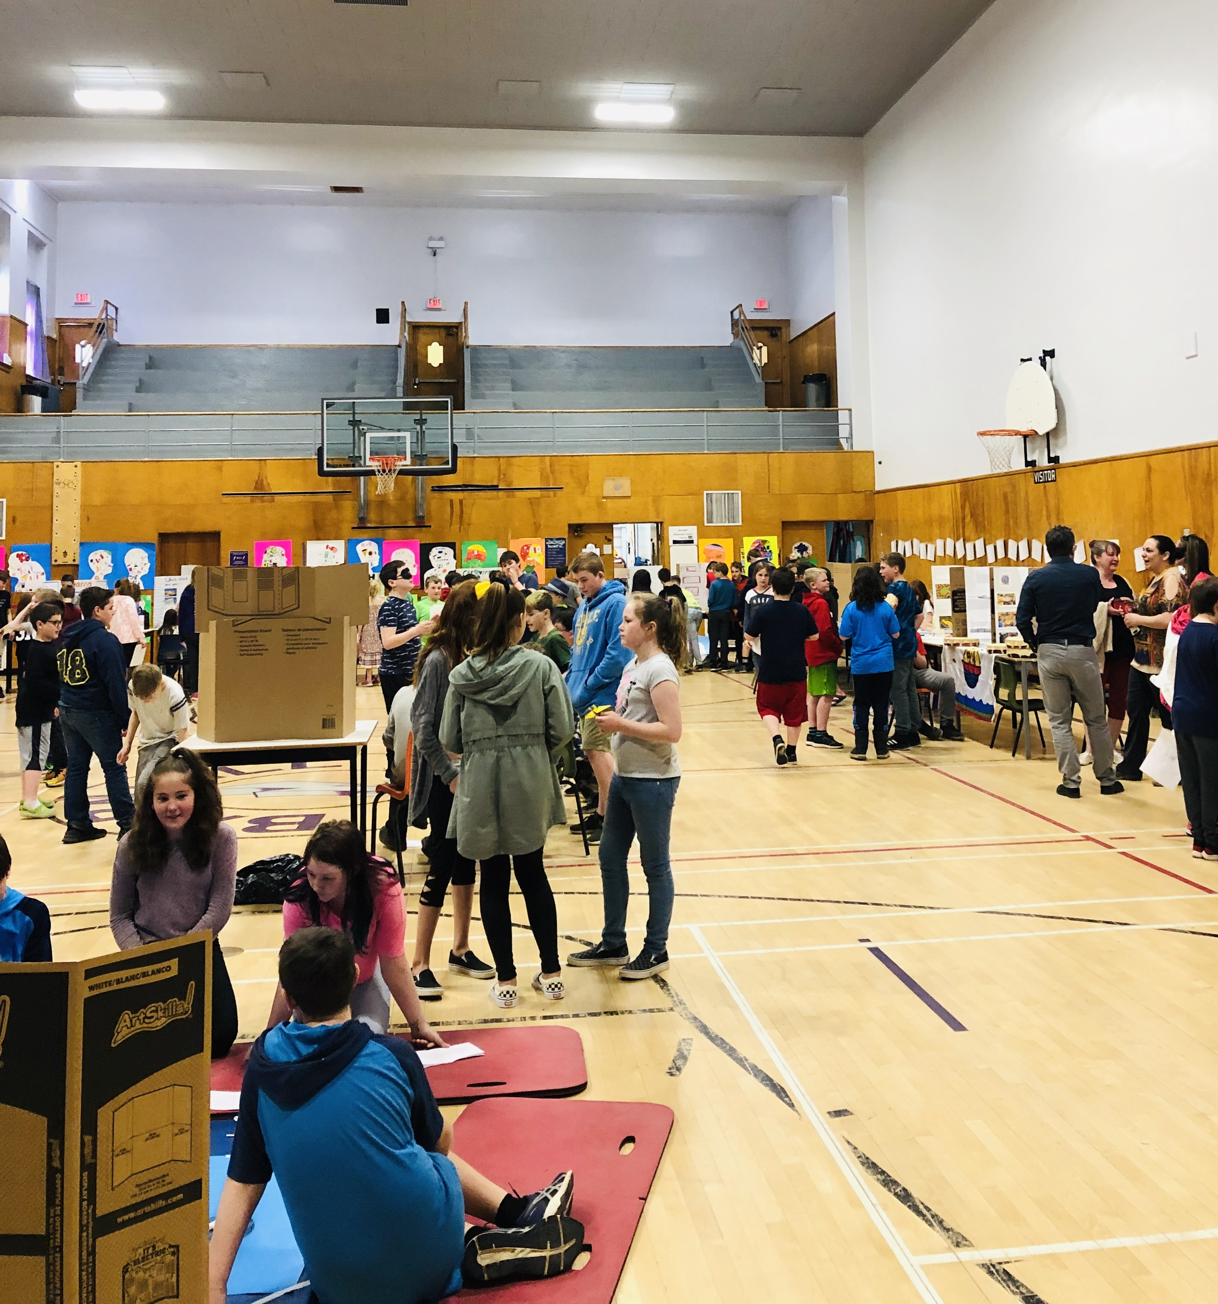
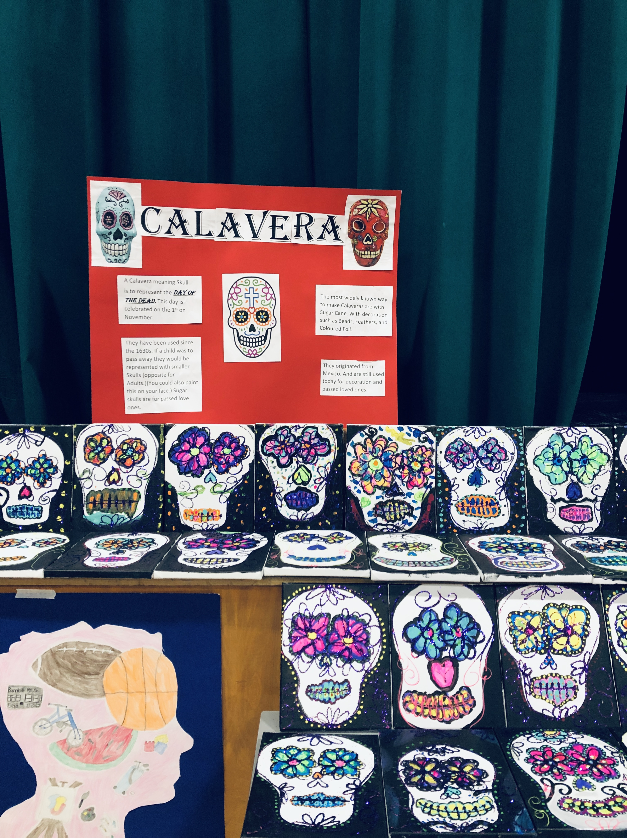
…2018-2019 Stories of Success Barnhill Memorial School- Laura Taylor’s Grade 6 Group

Slide 6
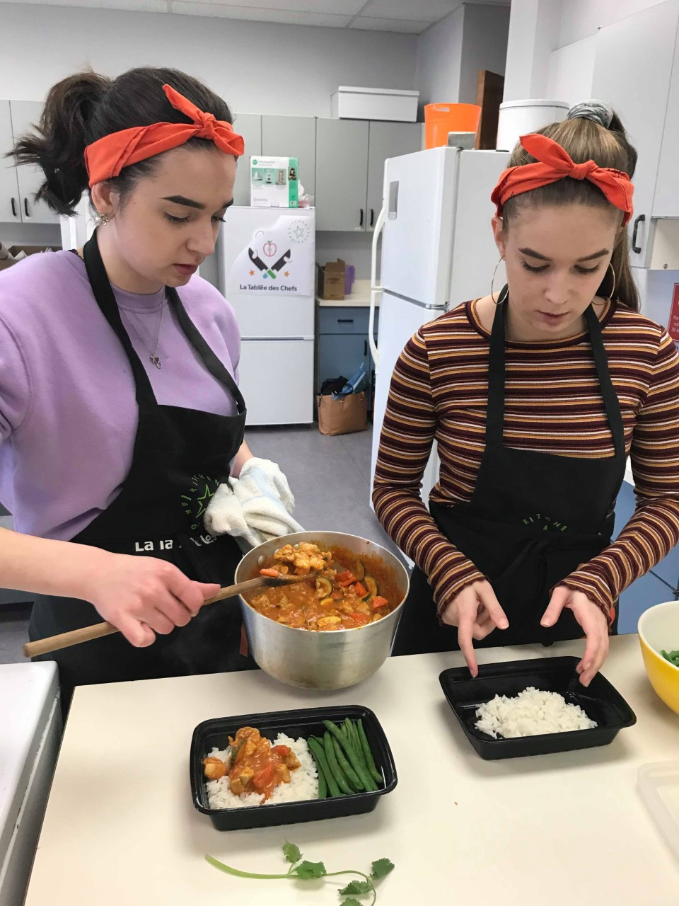
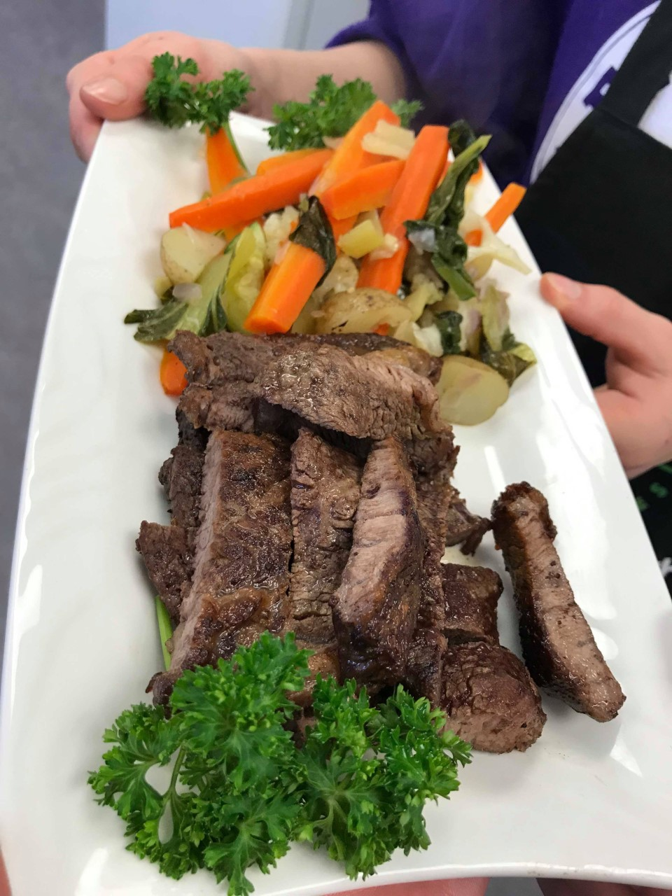
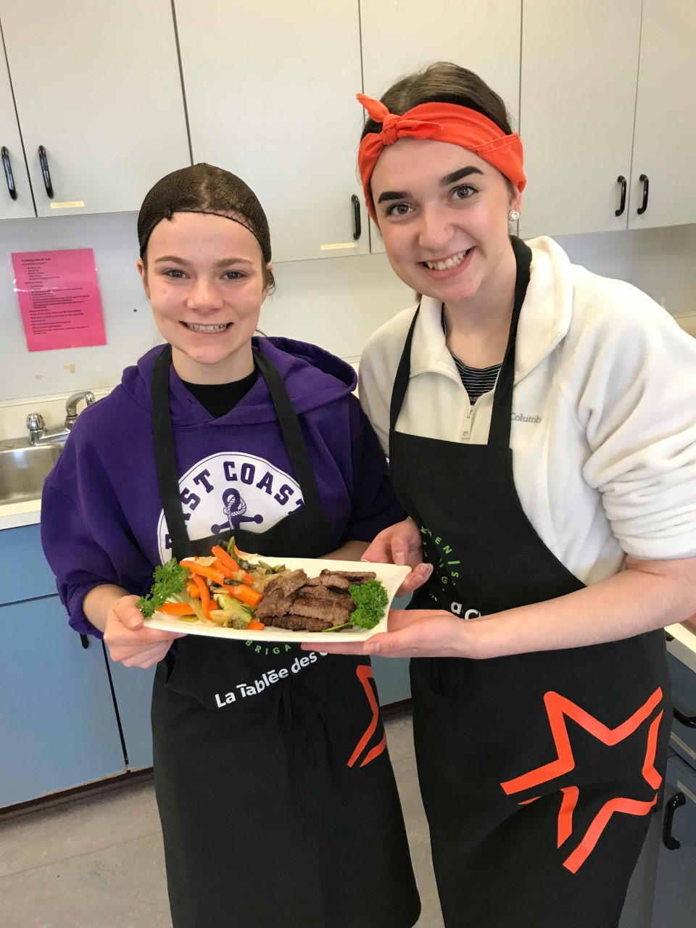
…2018-2019 Stories of Success Harbour View High School- Jacinta Gallagher’s Culinary Tech Group

Slide 7
The Future of ASD-S Innovation Grants 2019-2020
$50, 000 for grants
Deadline to Apply November 1st, 2019
PLCs are encouraged to collaborate
Grants awarded based on rubric score
Post grant survey
New- Student and Teacher Testimonials

Slide 8
Support for Innovative & Engaging Practices September Summary
Worked with 21 Teacher Teams
Met with 7 Outside Partners
Attended Professional Learning

Slide 9
Goals for 2019-2020
Assisting with grant applications
Assist PLCs
Communication Opportunities
Setting up Partnerships
Data Collection- Qualitative and Quantitative
Provide PL opportunities to ASD-S Staff
Supper Seminar Series
Global Competencies
MyBluePrint

Slide 10
Projects on The go
Partner with Offline Board Game Café- Middle School Curriculum-linked Boardgame List
Embed Global Competencies in the curriculum
Best Practices for Learning Commons

